Slide 1

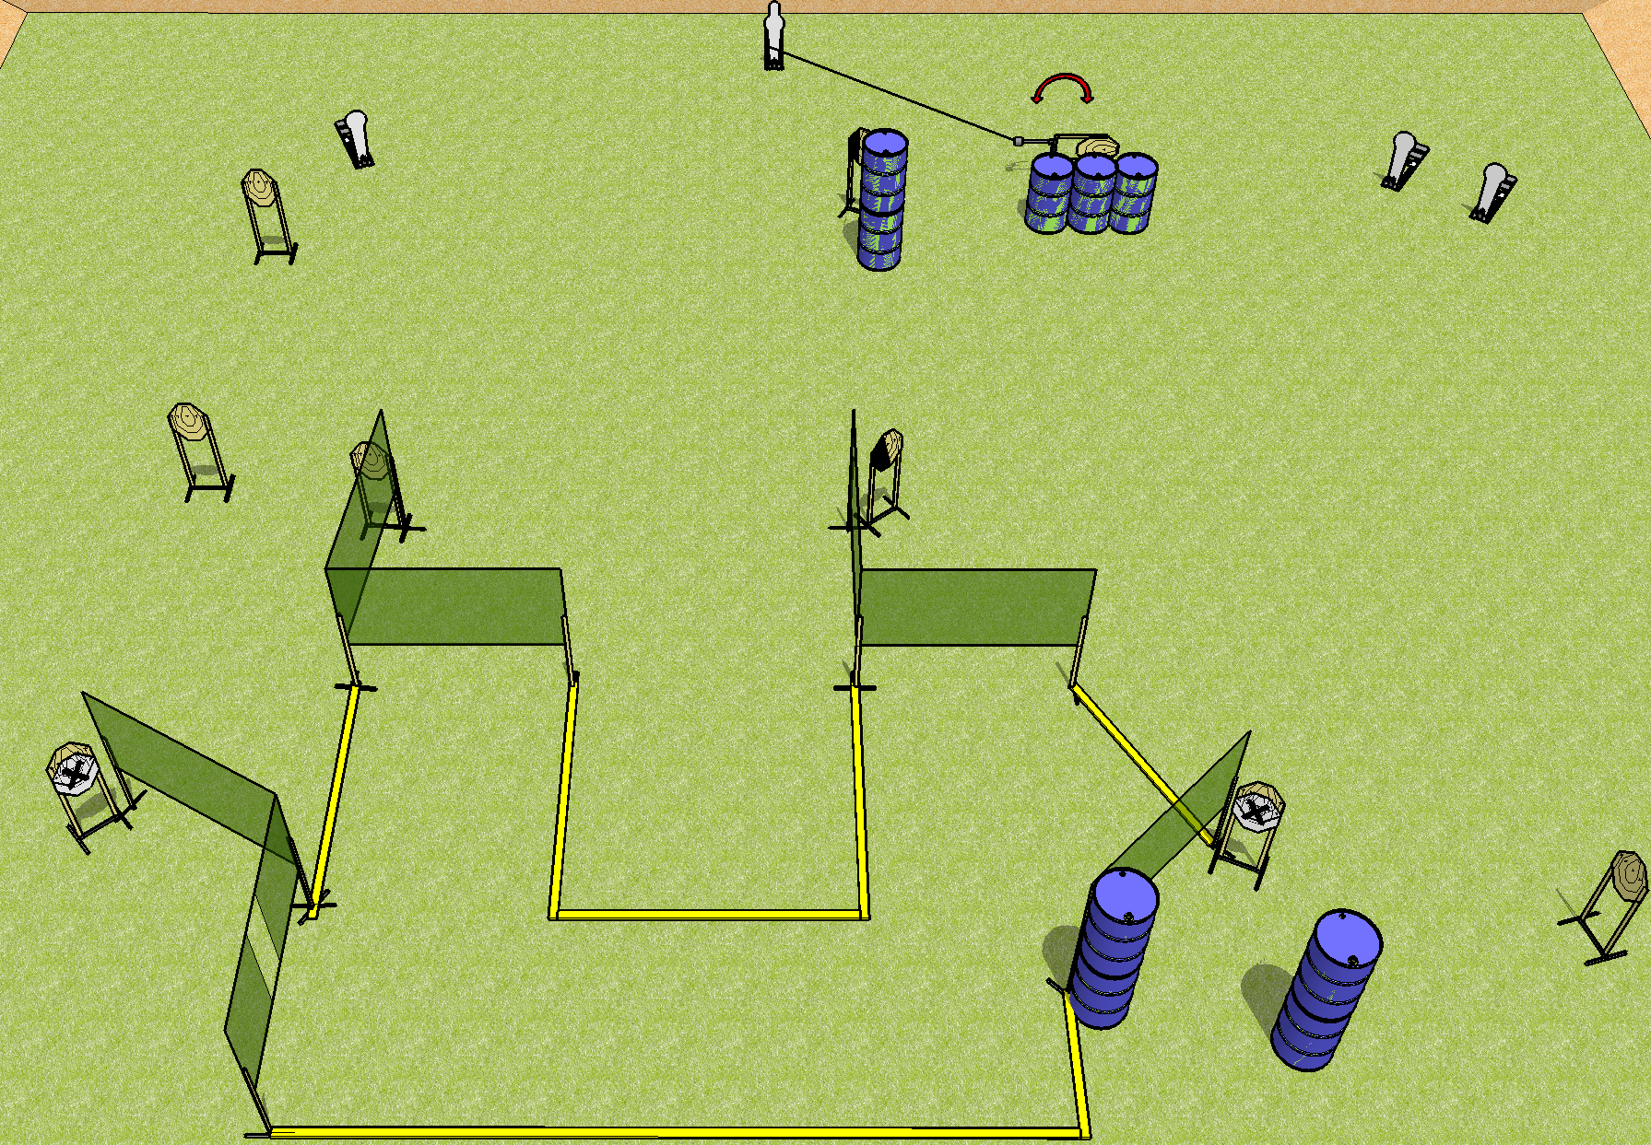
 | Dothan Practical Shooters – USPSA Match Ship It Course Designer : Drew Coleman Bay: A2
Round Count 22 rounds 9 IPSC 1 pepper popper, 3 colt poppers
Equipment List 12 wall feet Swinger + cable + fall forward popper 1 left diag, 1 tux 9 targets (7 + 2NS)

Slide 2
Ship It
Written Stage Briefing
Scoring: Comstock Rounds: 22
Targets: 9 IPSC, 4 steel
Handgun start position: anywhere inside the shooting area, wrists below belt. Handgun is loaded and holstered.
PCC start position: anywhere inside the shooting area, stock on belt. Loaded carbine is held with both hands, stock on belt, safety on.
Stage Procedure: on the audible start signal, engage the targets as they become available from within the shooting area. The swinger is activated by the pepper popper and remains visible at rest.

